Slide 1
Density and Archimedes
Year 7 Science

Slide 2

Review
How much matter
Define mass.
What are the units for mass?
Define volume.
What are the units for volume?
Define density.
What are the units for density?
What is the mathematical formula to find density?
Kg
How much space
L
How much mass for its volume
Kg/L
Density = mass ÷ volume

Slide 3
Learning Intentions
Mixtures, including solutions, contain a combination of pure substances that can be separated using a range of techniques.

Slide 4
Success criteria
Explain how displacement of water allows volume to be measured.
Explain why pure gold and mixed gold have different densities.

Slide 5
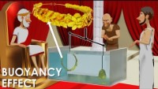

Slide 6
Worksheet: Archimedes and the Golden Crown

Slide 7
Success criteria
Explain how displacement of water allows volume to be measured.
Explain why pure gold and mixed gold have different densities.
Describe two different ways Archimedes measured density.

